Slide 1

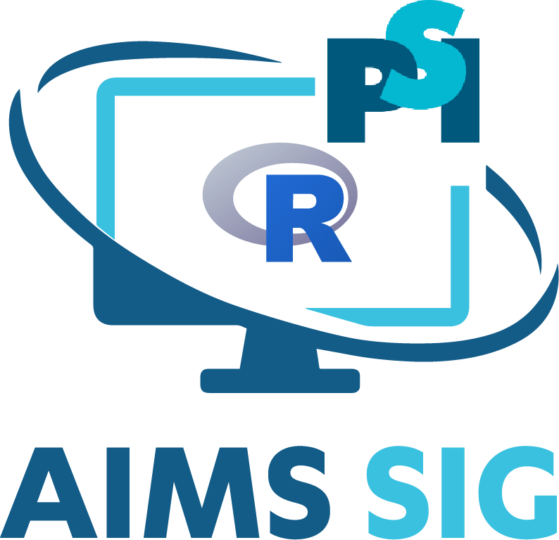
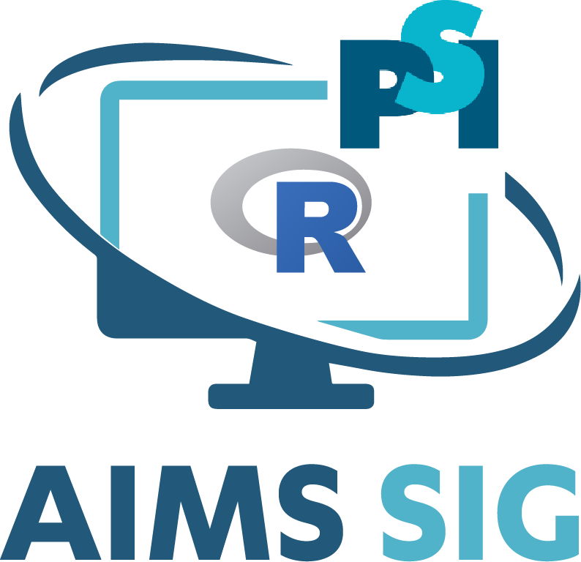
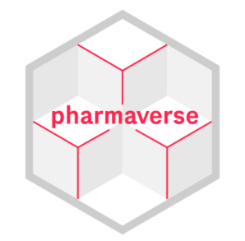



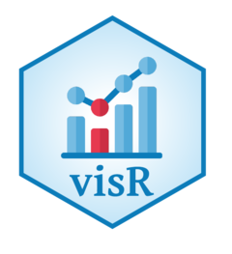


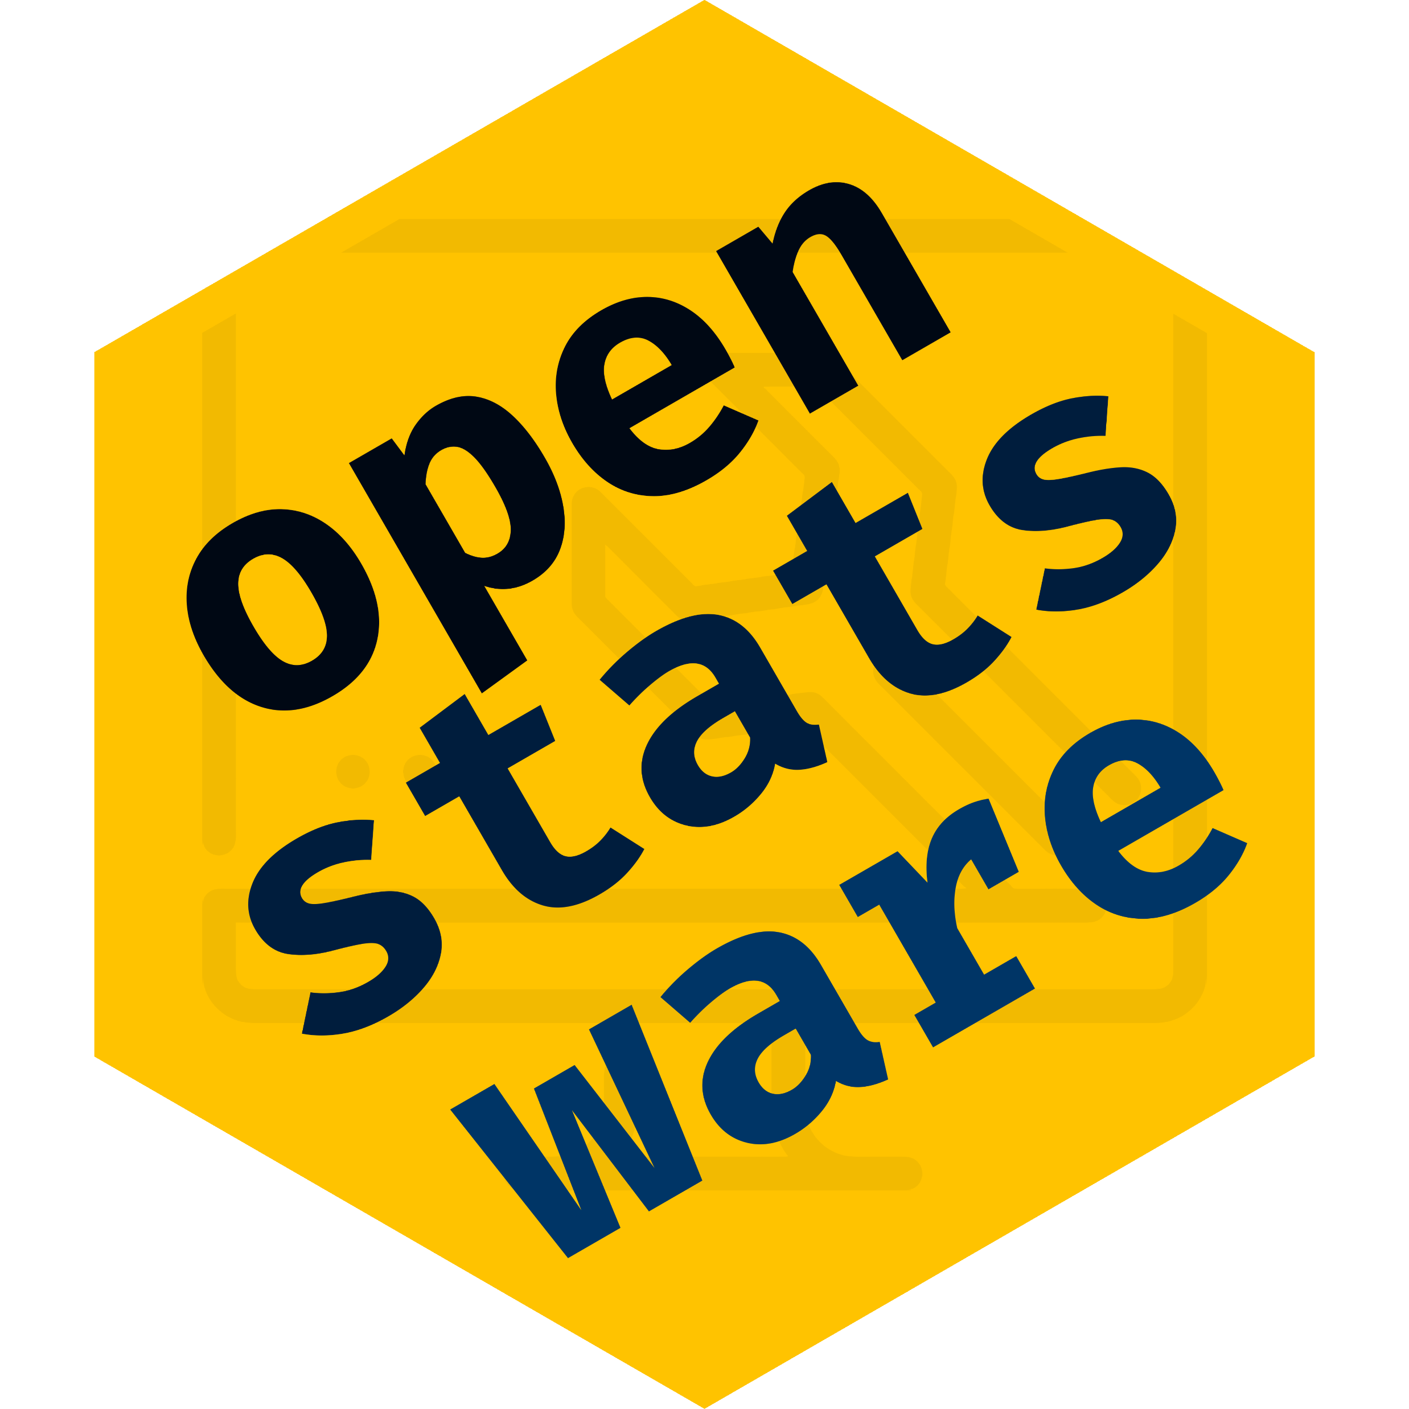


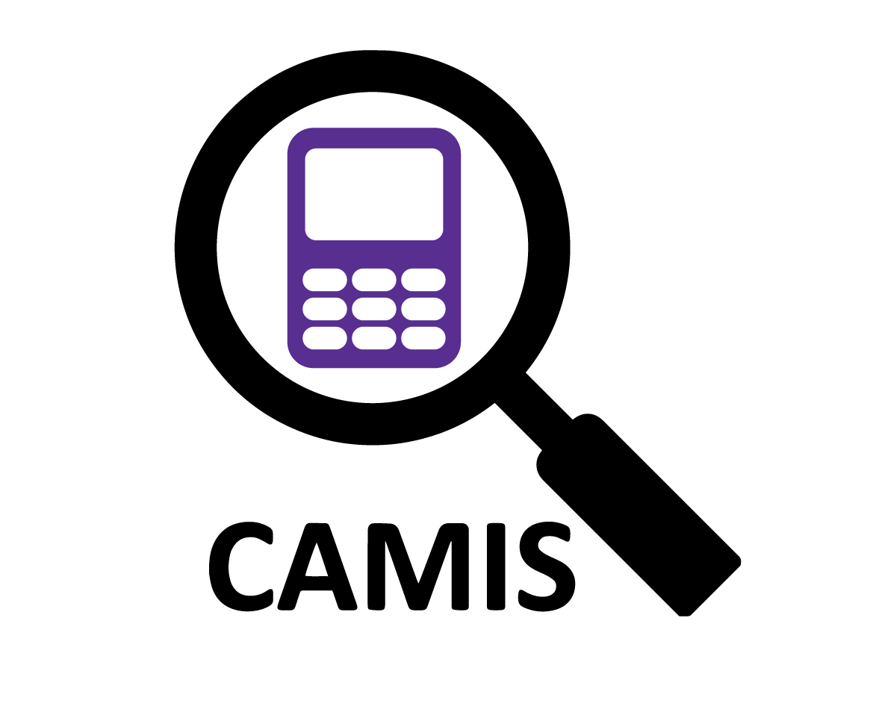


PSI
Industry
Packages
Promote, support and contribute to researching the use of R within the industry
Shared development/
maintenance/
solutions/
governance
Tables
Package
Webinars
RTRS
Interactive graphics app for monitoring clinical trial safety
R Adoption Series
R Tables for Regulatory Submissions
Code for different tables from different packages
Multiple case studies
Recordings
Panels
Discussions
[R consortium]
[R Consortium]
Package
PHUSE
Conference
Software
Engineering
Visualising data analysis results in the clinical development process
Best practices
Data Visualisation &
Open Source Technology
Emerging Trends & Innovation
Engineer packages – MMRM
Develop good SWE practices
Virtual and free
Focused on the use of R in the development of pharmaceuticals
Working groups with multiple projects
Submissions
User Group
Analysis
Package
Validation
R Submissions WG
Open-source repository
comparing code for statistical methods
in different languages
Modularized
toolbox for
developing ADaM datasets
static outputs
shiny
ADaM dataset
container, json
R amongst other software
Life science/health research
Technological solutions/ regulatory support/
events
5 pilots
White paper
Riskmetric
package and app
[R consortium]
[R consortium]
Collaborations in Medical Research

